Slide 2
Project Nautilus
Dell Internal & Confidential

Slide 3
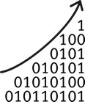


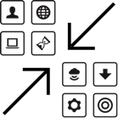
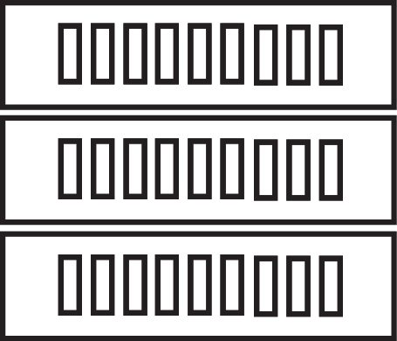


Market Drivers
Massive
Data Growth
Emergence of
Real-Time Apps
Monetize Data
with Analytics
Rapid Dissemination
of Data to Apps
Data Velocity
and Variety
Infrastructure Commoditization
and Scale-Out
Open Source
Community

Slide 4




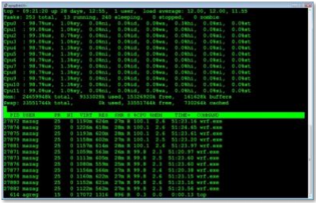



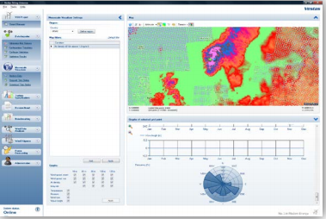

Today’s “Accidental Architecture”
Batch
Sensors
DR Site
MirrorMaker
Interactive exploration by Data Scientists
Mobile Devices
App Logs
Real-Time
Real-time intelligence at the NOC

Slide 5
A New Architecture Emerges: Streaming
A new class of streaming systems is emerging to address the accidental architecture’s problems and enable new applications not possible before
Some of the unique characteristics of streaming applications
Treat data as continuous and infinite
Compute correct results in real-time with stateful, exactly-once processing
These systems are applicable for real-time applications, batch applications, and interactive applications
Web-scale companies (Google, Twitter) are beginning to demonstrate the disruptive value of streaming systems
What are the implications for storage in a streaming world?

Slide 6





A Streaming Case Study at Twitter
Problem Statement
For an incoming Tweet rate of 1.5 million Tweets/second, implement sentiment analysis queries over live tweets as well as historical ones
Solution
Replace STORM w/ Flink to get correct real-time results
Kafka Partition
K/V
Real-Time
Kafka Partition
Persist correct hourly aggregates into Time Series DB directly from Flink eliminating the need for the Hadoop batch infrastructure
Kafka Partition
99.5% reduction in the hardware when deploying the unified architecture
Event Logger
Pub-Sub
Parse/Transform/Filter
hourly
Utilize stateful properties of Flink to eliminate large external K/V store
HDFS
Time
Series
DB
Batch
Implement recent queries directly against Flink’s internal state

Slide 7

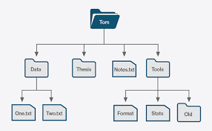
Let’s Rewind A Bit: The Importance of Log Storage
Traditional Apps/Middleware
Streaming Apps/Middleware
BLOCKS
Structured Data
Relational DBs
FILES
Unstructured Data
Pub/Sub
NoSQL DBs
OBJECTS
Unstructured Data
Internet Friendly (REST)
Scale over Semantics
Geo
LOGS
Append-only
Low-latency
Tail Read/Write

Slide 8
The Importance of Log Storage
The Fundamental Data Structure for Scale-out Distributed Systems
High Throughput
Low Latency
catch-up reads
tailing reads
writes
APPEND-ONLY LOG
…
x=5
z=6
y=2
x=4
a=7
y=5
…
older
newer

Slide 9
Our Goal: Refactor the “Accidental Storage Stack”
Kafka
Cassandra et al
Using Logs as a Shared Storage Primitive
Ingest Buffer & Pub/Sub
Proprietary
Log Storage
NoSQL DB
Proprietary
Log Storage
Ingest Buffer & Pub/Sub
NoSQL DB
Search
Analytics Engines
“Pravega Streams”
Local Files
Local Files
Scale-out SDS
DAS
DAS

Slide 10
Introducing Pravega Streams
A New Log Primitive Designed Specifically For Streaming Architectures
Pravega is an open source distributed storage service offering a new storage abstraction called a stream
A stream is the foundation for building reliable streaming systems: a high-performance, durable, elastic, and infinite append-only log with strict ordering and consistency
A stream is as lightweight as a file – you can create millions of them in a single cluster
Streams greatly simplify the development and operation of a variety of distributed systems: messaging, databases, analytic engines, search engines, and so on

Slide 11
Pravega Architecture Goals
All data is durable
Data is replicated and persisted to disk before being acknowledged
Strict ordering guarantees and exactly once semantics
Across both tail and catch-up reads
Client tracks read offset, Producers use transactions
Lightweight, elastic, infinite, high performance
Support tens of millions of streams
Dynamic partitioning of streams based on load and throughput SLO
Size is not bounded by the capacity of a single node
Low (<10ms) latency writes; throughput bounded by network bandwidth
Read pattern (e.g. many catch-up reads) doesn’t affect write performance

Slide 12
Architecture
Real-Time / Batch / Interactive
Predictive Analytics
Other Apps & Middleware
Messaging Apps
Stream Processors: Spark, Flink, …
Streaming Storage System
Pravega Design Innovations
Zero-Touch Dynamic Scaling
Automatically scale read/write parallelism based on load and SLO
No service interruptions
No manual reconfiguration of clients
No manual reconfiguration of service resources
Smart Workload Distribution
No need to over-provision servers for peak load
I/O Path Isolation
For tail writes
For tail reads
For catch-up reads
Tiering for “Infinite Streams”
Transactions For “Exactly Once”
Stream
Abstraction
Pravega Streaming Service
Cache
(Rocks)
Cloud Scale Storage
(Isilon or ECS)
High-Throughput
High-Scale, Low-Cost
Low-Latency Storage
Auto-Tiering
Apache Bookkeeper

Slide 13
Zero-Touch Scaling: Segment Splitting & Merging
Stream S
Data
Keys
3
Segment 0
Segment 1
Segment 5
Segment 6
Segment 7
2
Segment 2
Segment 3
1
Segment 4
0
t0
t1
t2
t3
t4
Time

